Slide 2
Pre - Teach Content Vocabulary
Tiny Seed
Petal
Big Seed
Leaf
Stem
Root

Slide 3
Sun
Rain
Sun
AIR
Soil

Slide 4
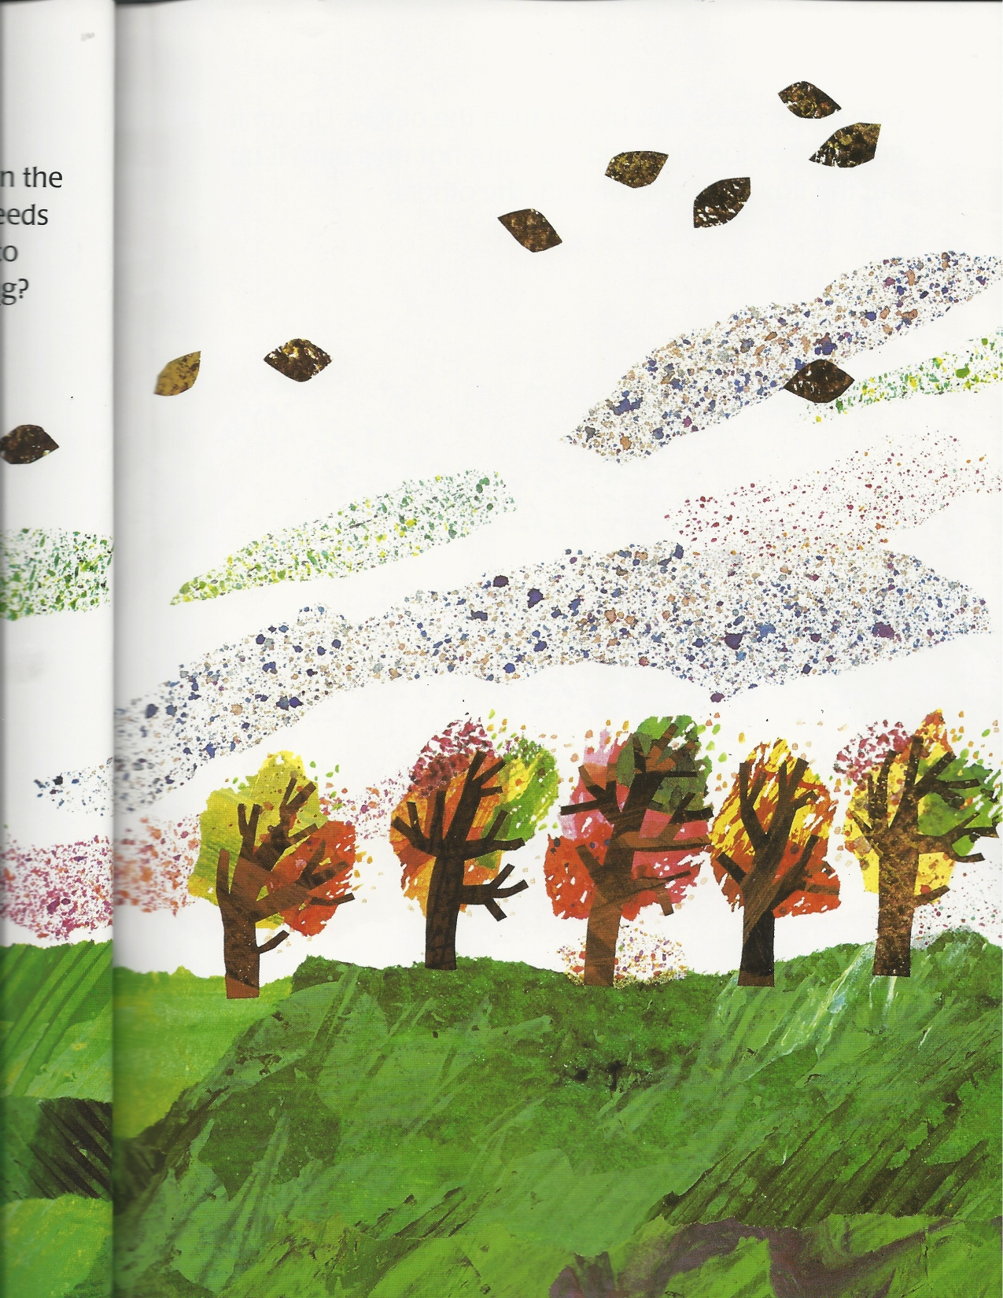
It is autumn. The wind blows one tiny seed and 9 big seeds up in the air.

Slide 5
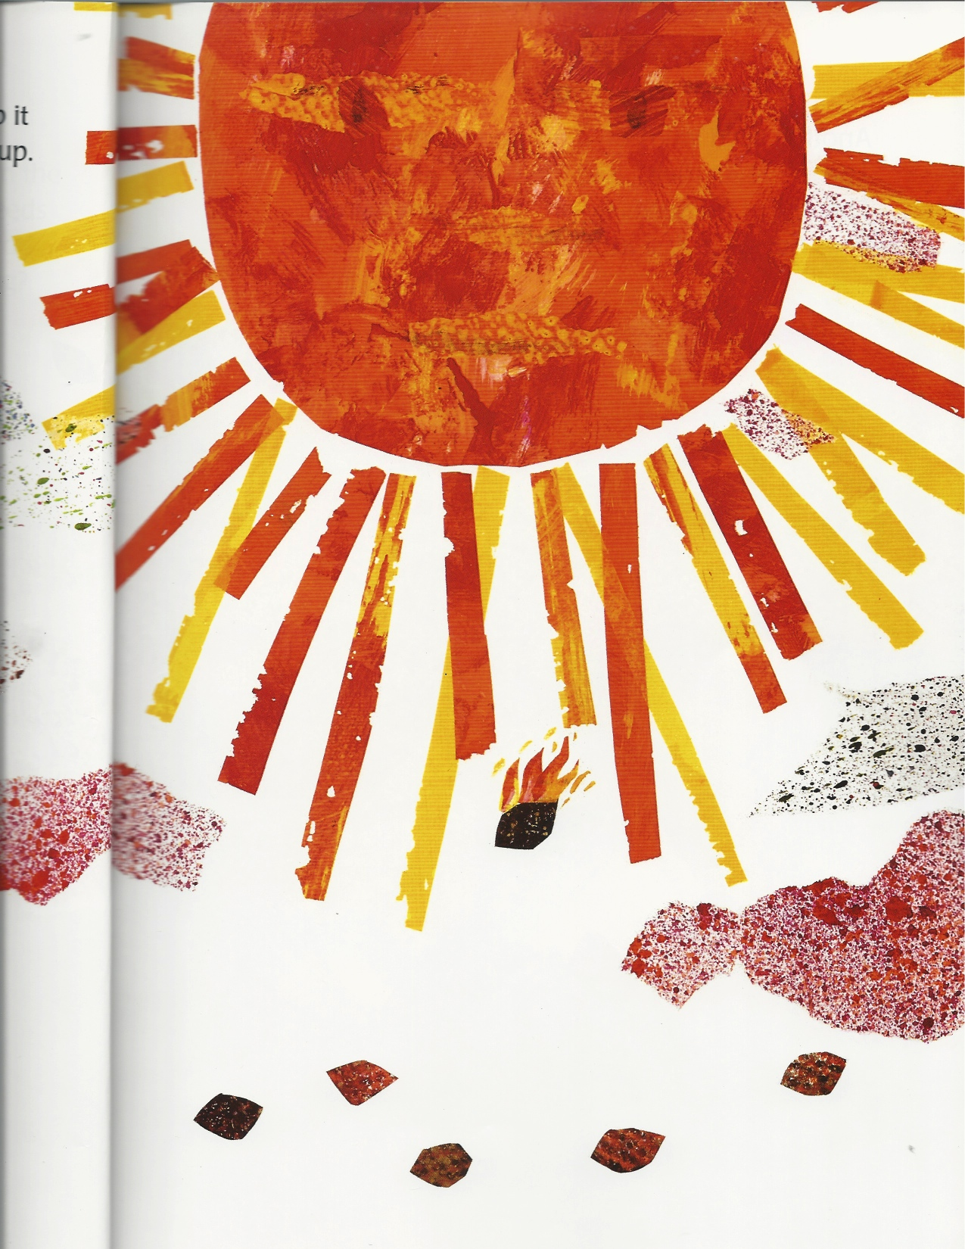
One big seed flies too high. The sun burns it up.

Slide 6
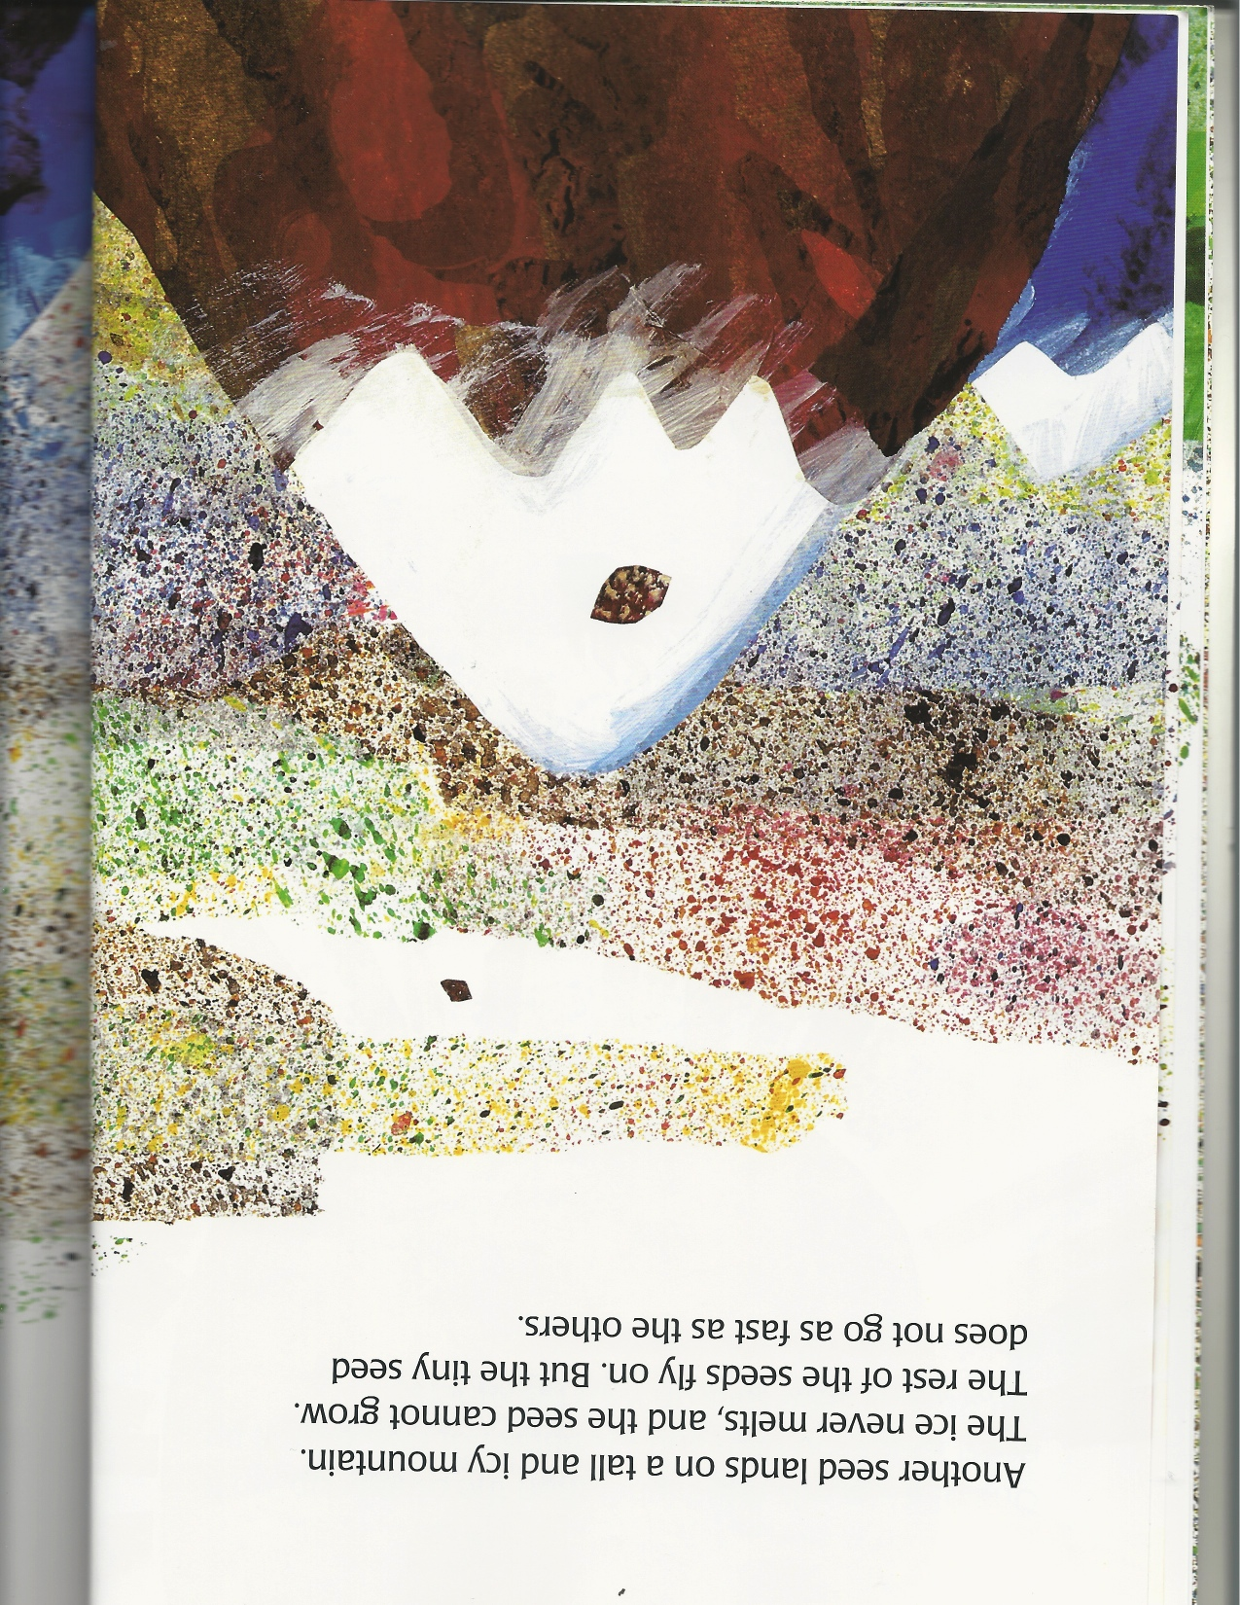
Another big seed lands on an icy mountain. It is too cold. The seed cannot grow in the ice.

Slide 7
Another big seed falls into the ocean. The ocean is too wet. The seed cannot grow only in the water.

Slide 8
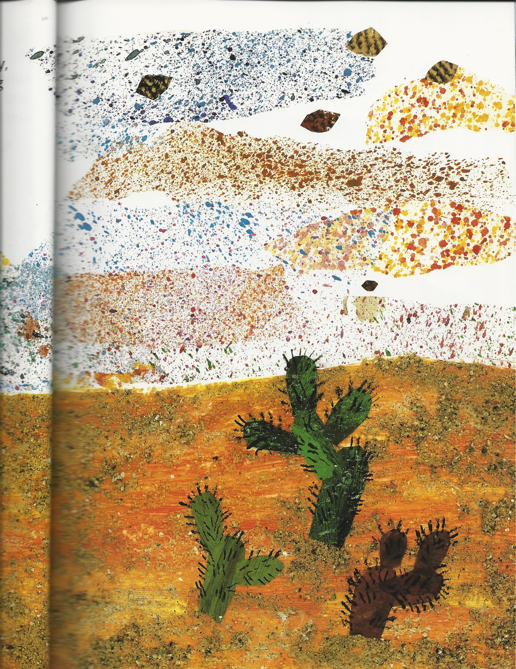
Another big seed falls onto the desert. The desert is too dry. The seed cannot grow.

Slide 9
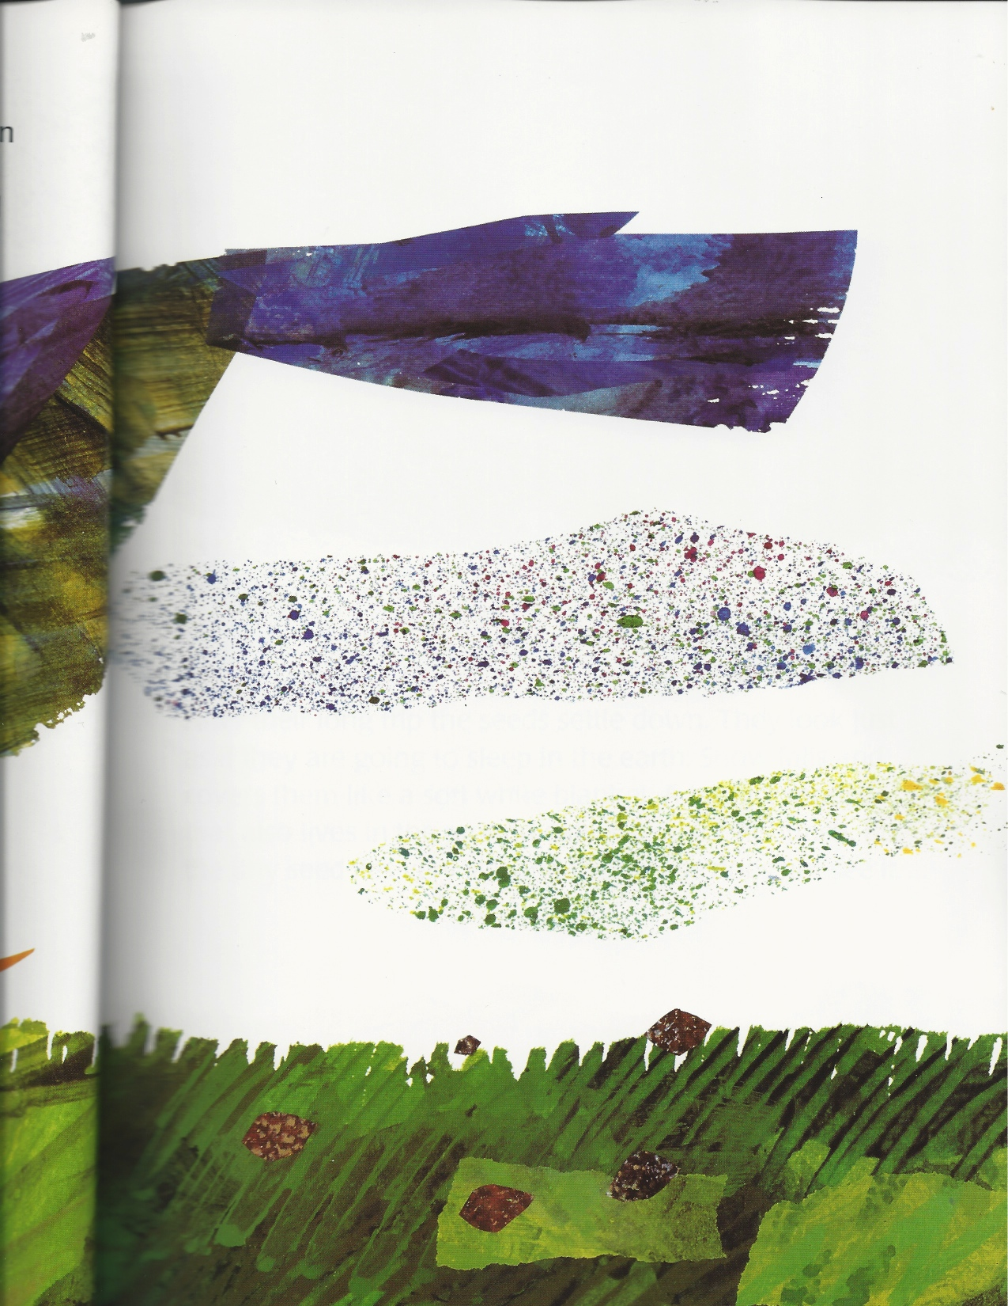
The wind stops. The seeds fall onto the ground. A bird eats one big seed.

Slide 10
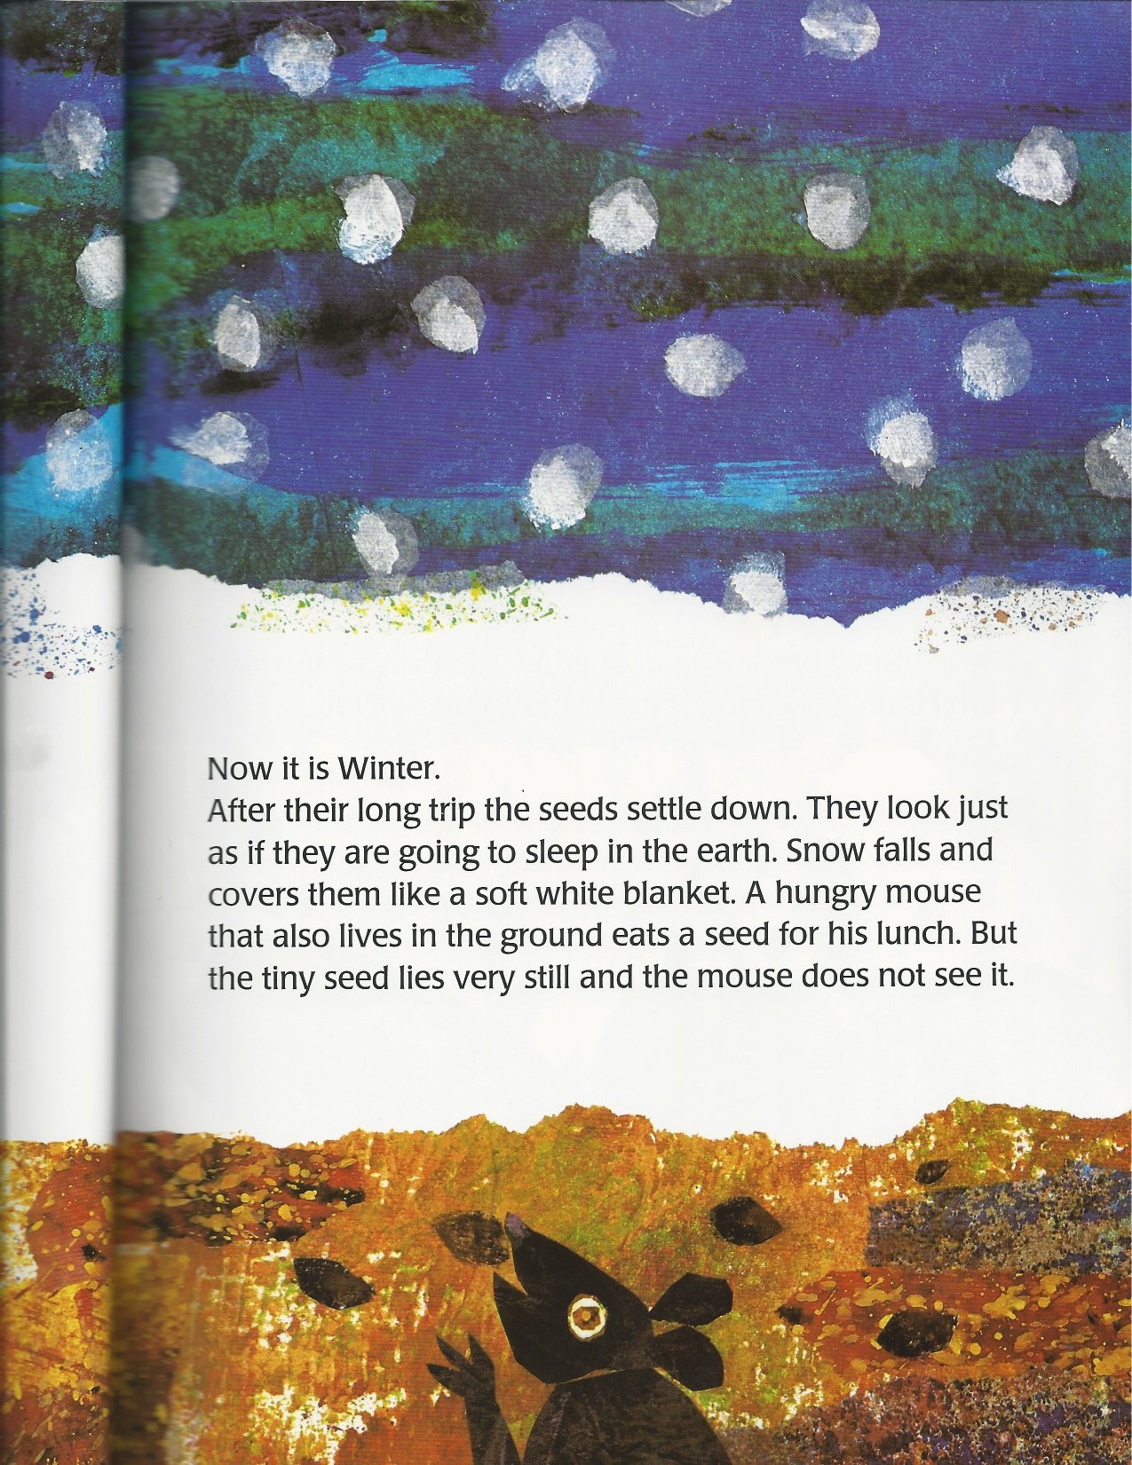
It is winter. The snow covers the tiny seed and four big seeds. A mouse eats another big seed.

Slide 11
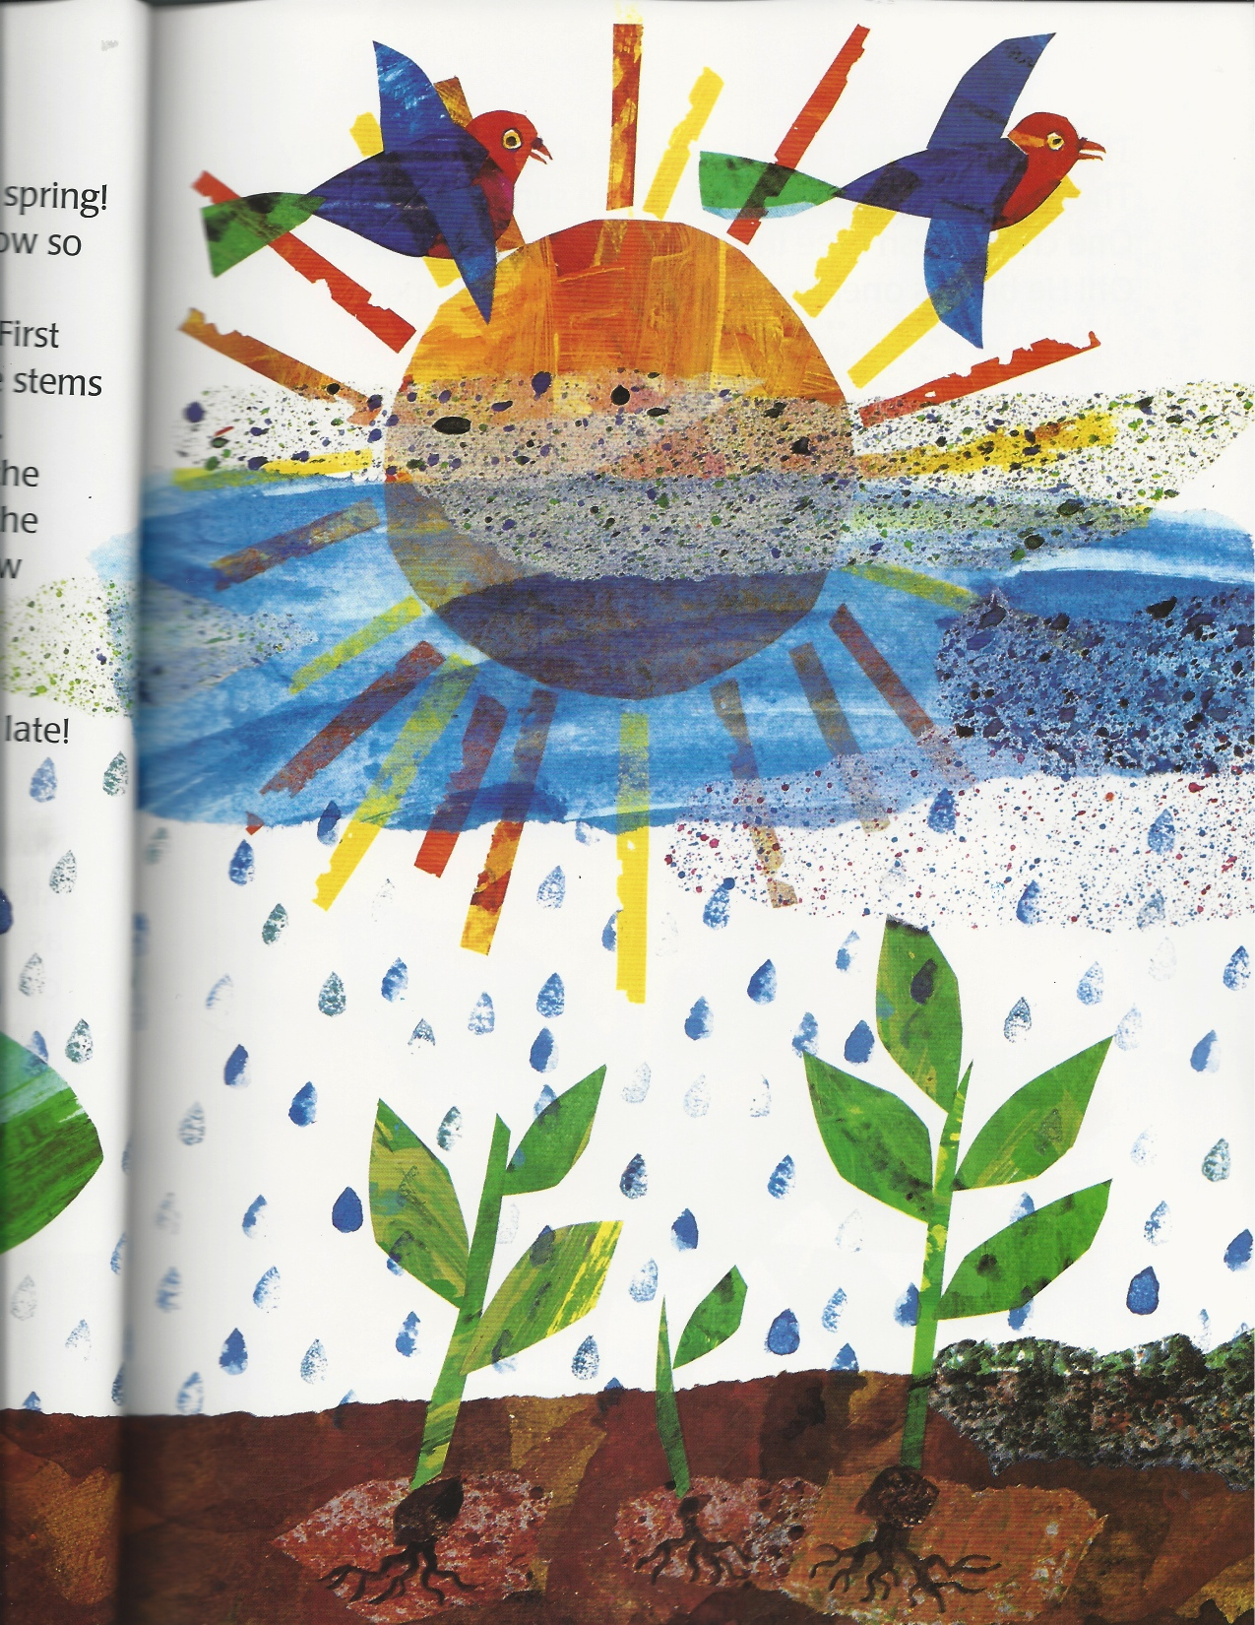
It is spring. It is sunny and rainy outside. The air is so fresh. The seeds begin to grow roots, stems, and leaves. The are plants.
A big fat weed grows faster than one plant. It takes all the sunlight and rain away from the plant. The plant cannot live without sunlight and rain. It dies.

Slide 12
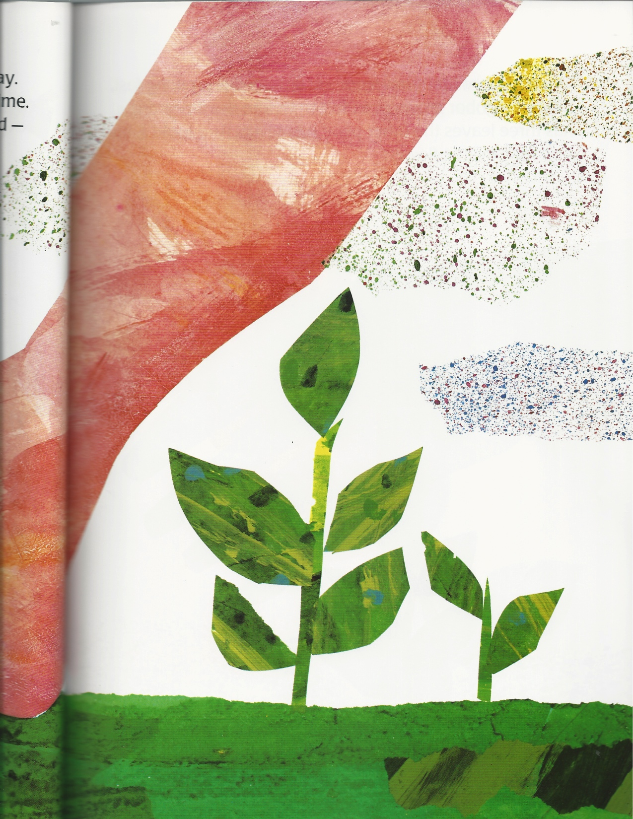
A child steps on another plant and breaks it. The plant dies.

Slide 13
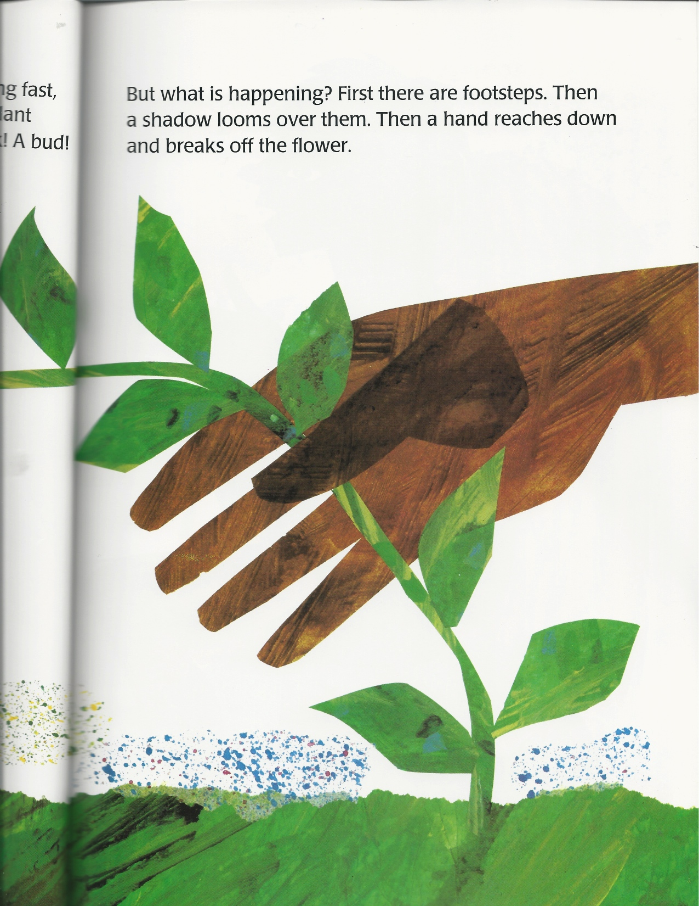
The tiny plant doesn’t have a flower yet.
The other one became a flower. A boy picks it up.

Slide 14
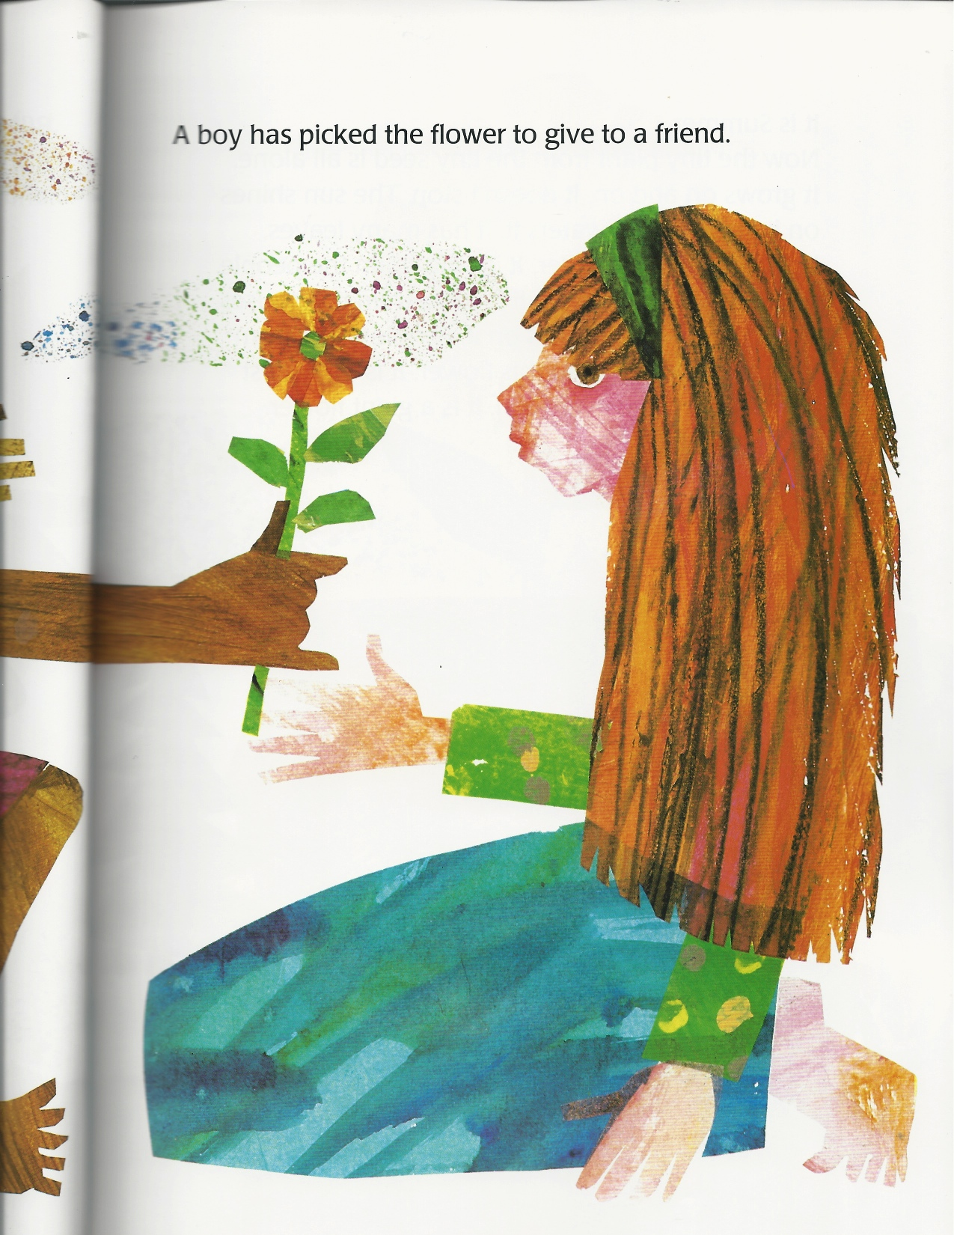
He gives the flower to his friend.

Slide 15
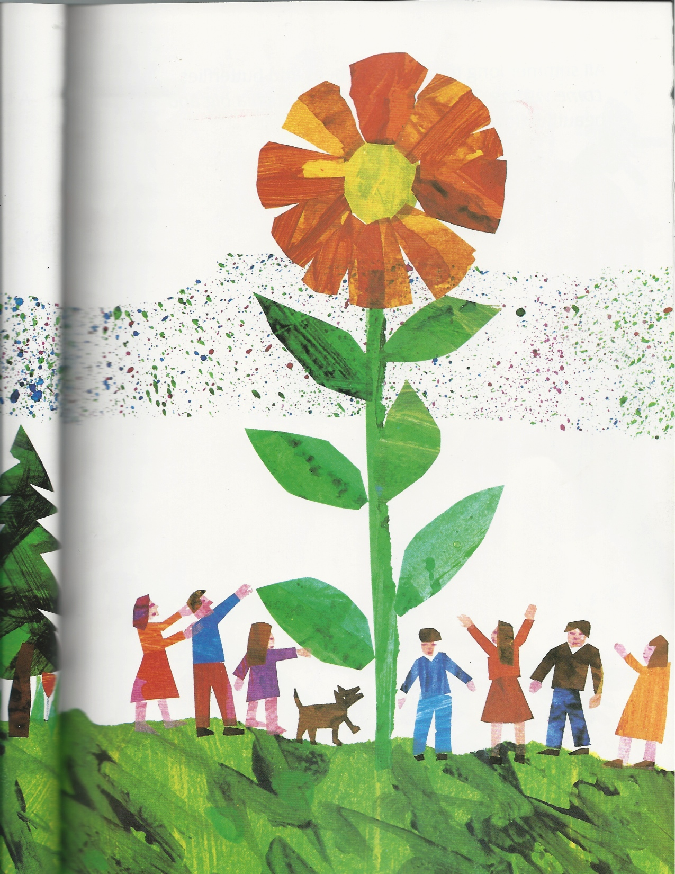
It is summer. The tiny seed became a beautiful flower. Everyone comes to look at it.

Slide 16
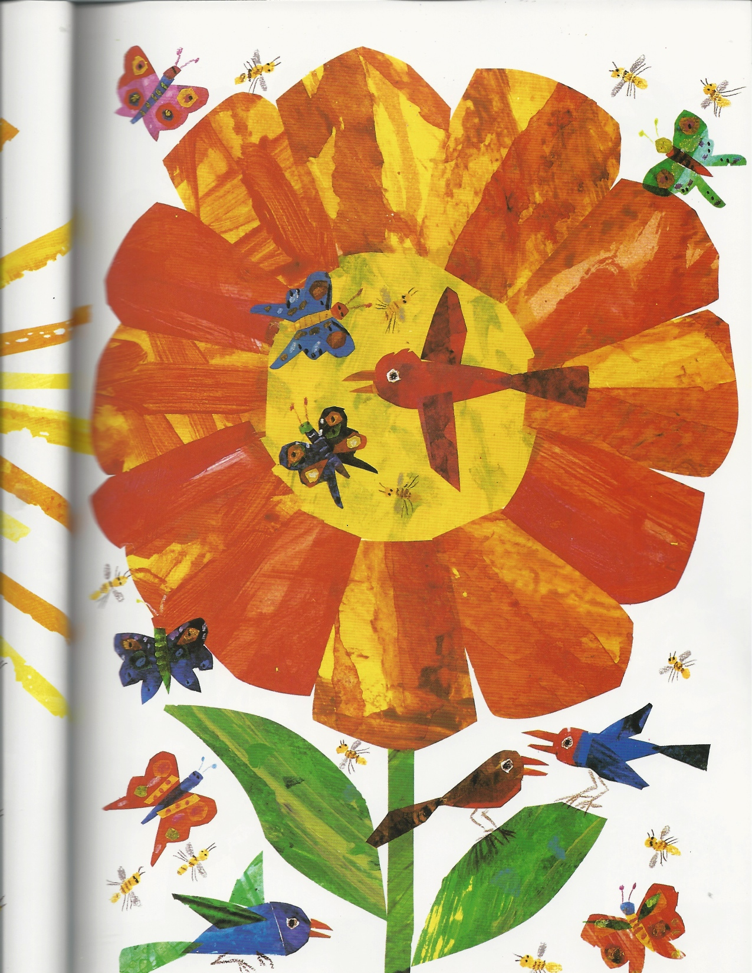
Birds and butterflies love the flower.

Slide 17
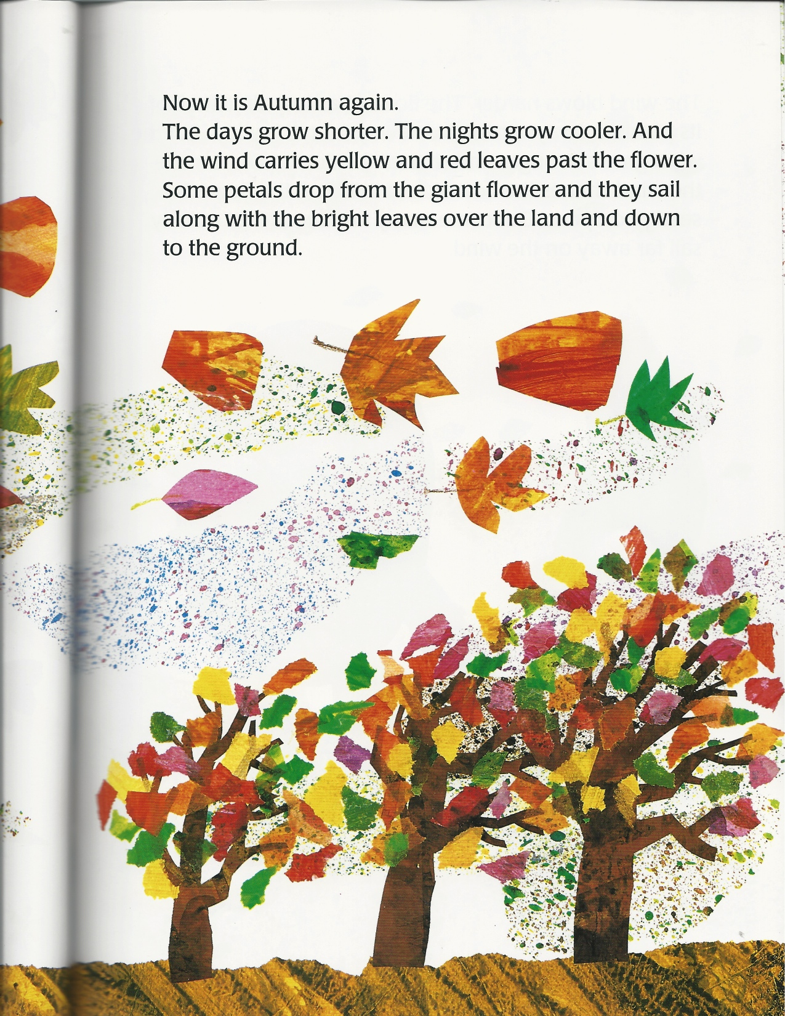
It is Autumn again. The wind is strong. The flower looses its petals and leaves.

Slide 18
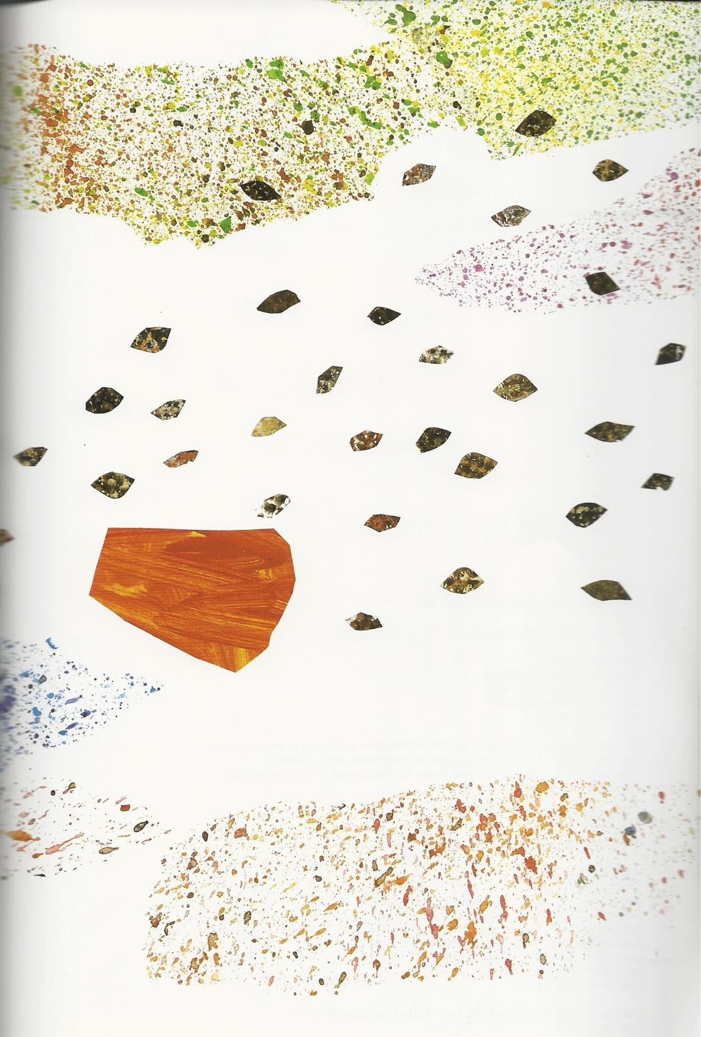
The winds picks up the seeds from the flower. One day the seeds will become flowers.

